Slide 1
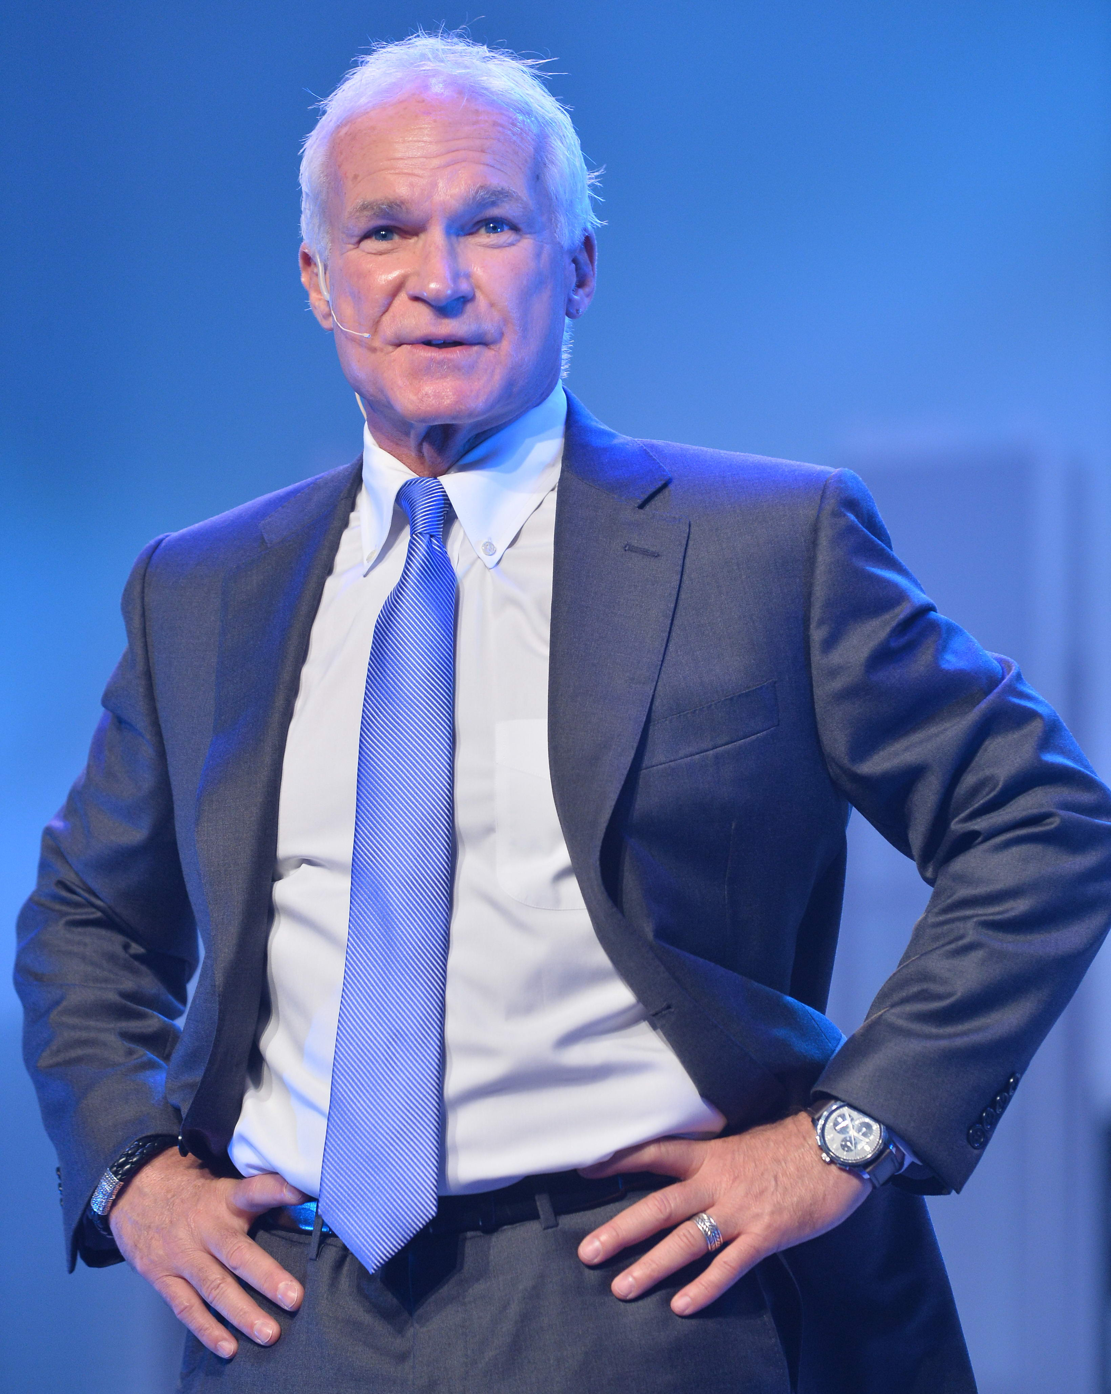
購物年金及超連鎖™系統的力量
The Power of Shopping Annuity and UnFranchise™ System – The WHY
Kevin Buckman
特別企劃顧問
Special Projects Consultant

Slide 2


超連鎖™事業系統
THE UNFRANCHISE SYSTEM
「這套系統讓創業家賺取可觀的永續收入，並且為全球消費者提供更佳的購物方式。」
系統核心是美安香港的管理業績紅利計劃(MPCP),獎勵每位超連鎖™店主(UFO):
  改變購買的品牌
  改變購物的方式
  建立兩個銷售團隊
“System for entrepreneurs to create a significant ongoing income, while providing consumers world wide with a better way to shop.”
At the heart of this system is Market Hong Kong’s Management Performance Compensation Plan (MPCP) that reward search UnFranchise Owner (UFO) for
  Changing brands of products
  Changing how they shop
  Building just two sales teams

Slide 3
購物年金
THE SHOPPING ANNUITY
「年金」指的是在特定期間內，每隔一段時間所發放給你的一筆固定款項。
例如︰連續20年，每月 HK$11,500
為了累積「年金」，你必須在年金開始每月發放前投資一筆資金。
例如︰固定金額US$340,000.00 @ 4% = 連續20年，每月US$1,500
An “Annuity” is a process by which a fixed payment is made to you at specified intervals for a specified length of time.
Example: HK$11,500 per month for 20 years
To fund the “Annuity” you must contribute a one-time payment before monthly payments may begin.
Example: USD $340,000.00 lump sum @ 4% = USD $1,500 month for 20 years

Slide 4
購物年金
THE SHOPPING ANNUITY
購物年金也是同樣的道理,唯一不同之處在...
超連鎖™店主投資的固定款項不是指$$$,而是指時間的累積﹗
時間(固定款項)= 每週8-15小時，持續24-36個月
執行4個基本步驟並確保你兩個銷售團隊也照著做...
你可以建立永續收入每週HK$11,500，而非20年每月HK$11,500
The “Shopping Annuity” works the same way with one major difference…
A UFO’s lump sum payment is made not in $$$, but in time!
Time (Lump Sum Payment) = 8-15 Hours/Week for 24-36 Months
By performing 4 basic steps and ensuring business partners of your 2 sales teams perform the same 4 steps
You can build a Shopping Annuity that pays HK$11,500 every week forever vs. HK$11,500 per month for 20 years.

Slide 5

購物年金由每位超連鎖™店主創造
THE SHOPPING ANNUITY BEGINS WITH EACH UFO
第一步：
以美安香港品牌產品取代你家中每月及每季的消費
Step 1-
Buy Market Hong Kong brands instead of brands you are currently buying for your households every 4-12 weeks
*超連鎖™店主因為使用美安產品，既慳錢(超連鎖™價格)丶又賺錢(賺取BV)
*UFOs save (UF Cost) and earn (BV compensation) for using products they see and represent
BV
每月Monthly __________
平均數目Avg.

Slide 6
購物年金由每位超連鎖™店主創造
THE SHOPPING ANNUITY BEGINS WITH EACH UFO
完成購物年金評量表
  時間價值
  美安香港品牌產品 (BV&IBV)
  你主修專案的產品 (BV)
  固定消費 (夥伴商店)
  每年固定消費(夥伴商店)
  輸入︰
  預算
Complete the Shopping Annuity Assessment
  Time Value
  Market Hong Kong Brand Products (BV & IBV)
  Your Major’s Product (BV)
  Regular Spending (Partner Stores)
  Annual Spending (Partner Stores)
  Inputs
  Projections

Slide 7
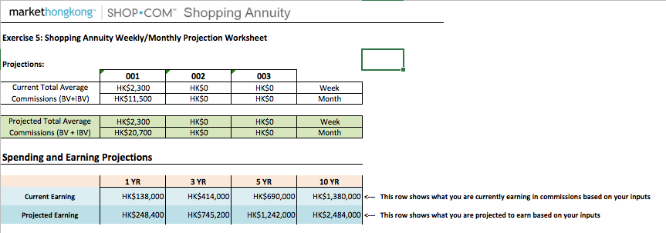
購物年金由每位超連鎖™店主創造
THE SHOPPING ANNUITY BEGINS WITH EACH UFO
時間價值
“Time
Value”

Slide 8
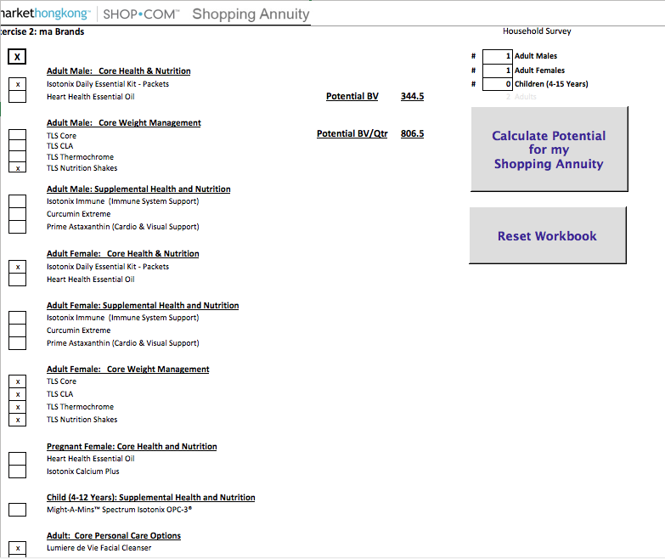
購物年金由每位超連鎖™店主創造
THE SHOPPING ANNUITY BEGINS WITH EACH UFO
美安香港品牌產品
“MA
Brand”

Slide 9
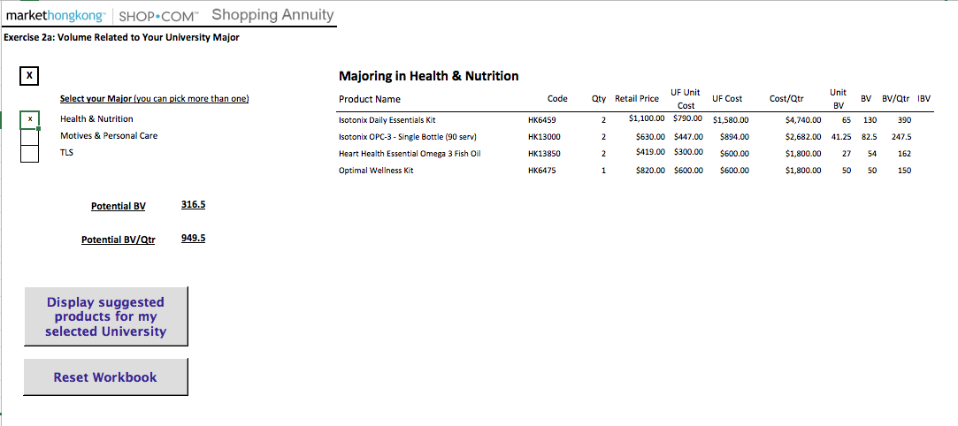
購物年金由每位超連鎖™店主創造
THE SHOPPING ANNUITY BEGINS WITH EACH UFO
你主修專案的產品
“Your Major”

Slide 10
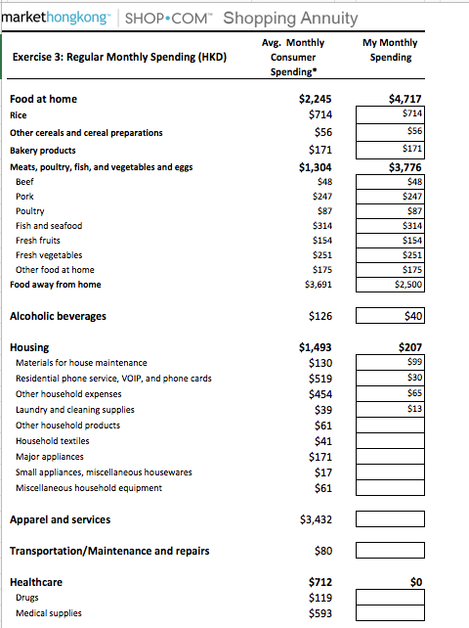
購物年金由每位超連鎖™店主創造
THE SHOPPING ANNUITY BEGINS WITH EACH UFO
  固定消費 (夥伴商店)
“Regular
Spending”

Slide 11
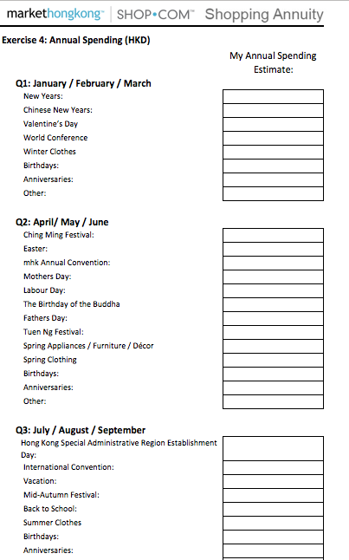
購物年金由每位超連鎖™店主創造
THE SHOPPING ANNUITY BEGINS WITH EACH UFO
  每年固定消費
  (夥伴商店)
“Annual
Spending”

Slide 12
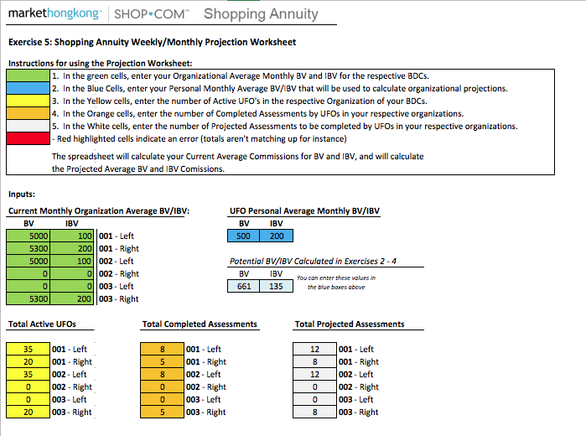
購物年金由每位超連鎖™店主創造
THE SHOPPING ANNUITY BEGINS WITH EACH UFO
  輸入︰
“Inputs”

Slide 13
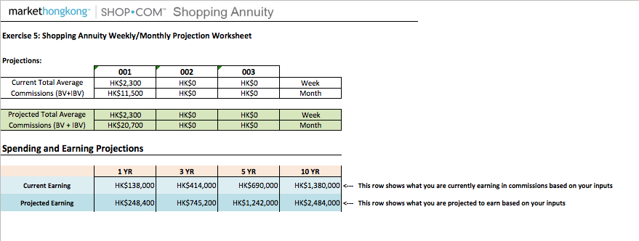
購物年金由每位超連鎖™店主創造
THE SHOPPING ANNUITY BEGINS WITH EACH UFO
預算“Projections”

Slide 14
購物年金由每位超連鎖™店主創造
THE SHOPPING ANNUITY BEGINS WITH EACH UFO
慳錢兼賺錢
成為產品的專家
賣自己也在使用的產品
以數量(BV & IBV)設定事業目標
領袖能力
Savings & Earning
Product of Your Products
Sell What You Use
Quantification (BV & IBV) to Set Business Goals
Leadership

Slide 15
購物年金由每位超連鎖™店主創造
THE SHOPPING ANNUITY BEGINS WITH EACH UFO
第二步:
透過你的HK.SHOP.COM網站到你原本就在消費的商店購買你家中每月丶每季丶各種場合所需的產品。
Step 2 -
Buy ALL other products you are currently buying for your households every month, quarter, season, special occasion… thru your HK.SHOP.COM website from the same stores
*超連鎖™店主在夥伴商店消費，既慳錢(優惠/特價)丶又賺錢(賺取IBV/現金回贈)
*UFOs save (deals/pricing) and earn (IBV compensation/Cashback) on partner store purchases
BV
Monthly __________
Avg.

Slide 16
購物年金由每位超連鎖™店主創造
THE SHOPPING ANNUITY BEGINS WITH EACH UFO
完成購物年金計劃評量表
  固定消費
  年度消費
  找出你購買這些產品的「夥伴商店」
  在自己的HK.SHOP.COM將這些夥伴商店設成一份「我的清單」
Complete the Shopping Annuity Assessment
  Regular Spending
  Annual Spending
  Identify “Partner Stores” where you make these purchases
  Create a “My List” of Partner Stores on your HK.SHOP.COM website

Slide 17
購物年金由每位超連鎖™店主創造
THE SHOPPING ANNUITY BEGINS WITH EACH UFO
慳錢兼賺錢
成為產品的專家
賣自己也在使用的產品
以數量(BV & IBV)設定事業目標
領袖能力
Savings & Earning
Product of Your Programs
Sell What You Use
Quantification (IBV) to set Business Goals
Leadership

Slide 18

購物年金由每位超連鎖™店主創造
THE SHOPPING ANNUITY BEGINS WITH EACH UFO
第三步 ︰
建立10-15名忠實顧客購買美安品牌產品以代替原使用產品... 並且還要..
請他們透過你的SHOP.COM網站購買其它所需產品
Step 3 –
Build a repeat customer base of 10-15 individuals that buy Market Hong Kong branded products instead of brands they are currently buying…
AND…
All other products they are currently buying thru your HK.SHOP.COM website…
*顧客可從購買中賺取現金回贈
*超連鎖™店主從這些購買中賺取BV及IBV
*Customers earn Cashback on purchases
*UFOs earn on BV & IBV from customer purchases
BV/IBV/Cashback
BV/IBV/Cashback
BV/IBV/Cashback
BV/IBV/Cashback
BV/IBV/Cashback
BV/IBV/Cashback
BV/IBV/Cashback
BV/IBV/Cashback
BV/IBV/
現金回贈Cashback
BV/IBV/Cashback
BV/IBV/Cashback
每月Monthly ___/___/___
平均數Avg.

Slide 19
購物年金由每位超連鎖™店主創造
THE SHOPPING ANNUITY BEGINS WITH EACH UFO
產品預覽 ─ 邀請
Motives預覽 ─ 邀請
健康講座101 ─ 邀請
與每位優惠顧客完成購物智囊
Product Previews – Invite
Motives Preview – Invite
Wellness 101 Presentations – Invite
Complete the Shop Advisor with each Preferred Customer

Slide 20
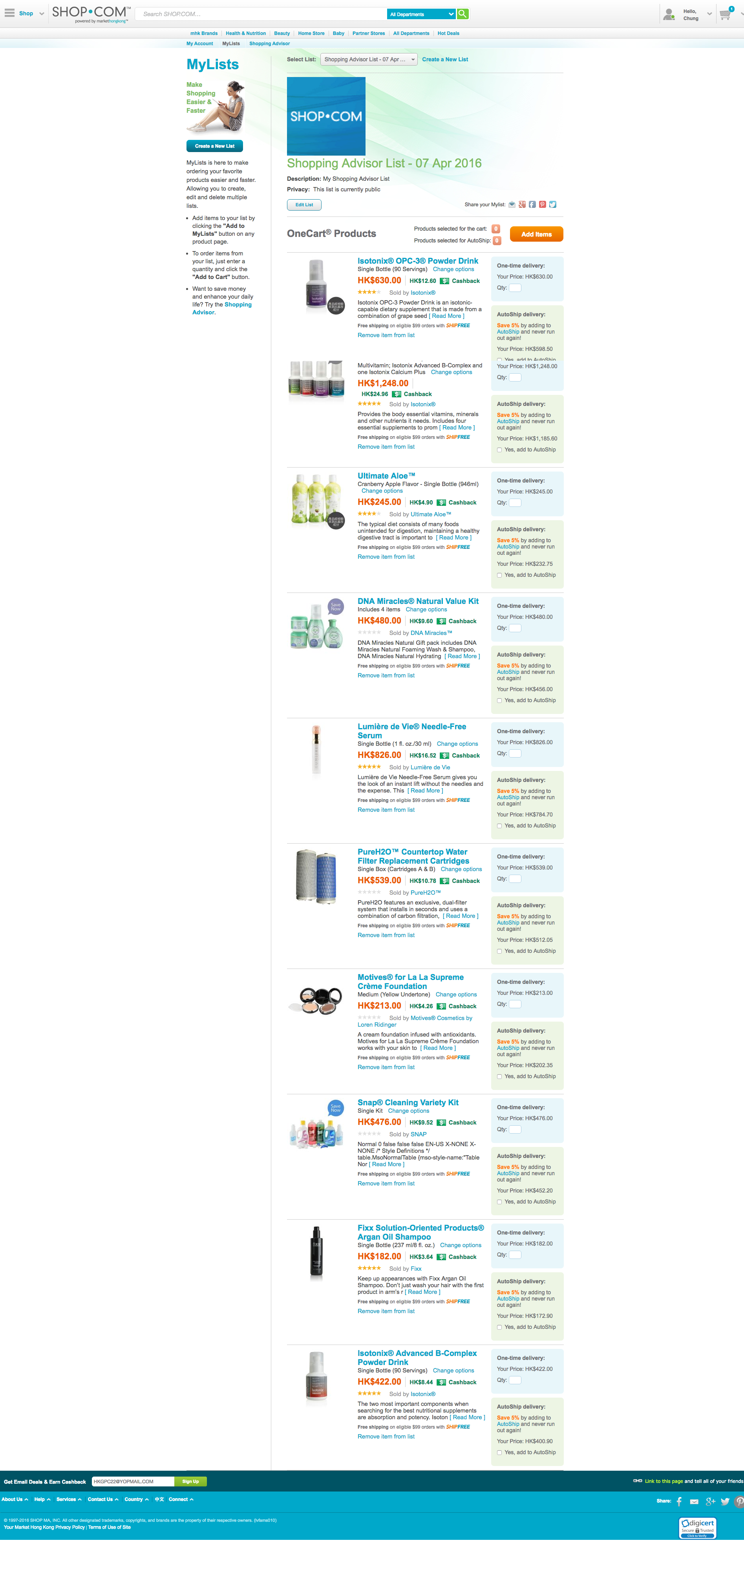
購物年金由每位超連鎖™店主創造
THE SHOPPING ANNUITY BEGINS WITH EACH UFO
購物智囊為優惠顧客整理之「我的清單」
“My List for PC from Shop Advisor”

Slide 21

購物年金由每位超連鎖™店主創造
THE SHOPPING ANNUITY BEGINS WITH EACH UFO
第四步︰
每季找出2位或更多想要改變自己經濟狀況的人，讓他們執行這四個基本步驟,並且... 建立2個銷售團隊!
Step 4 - Find 2 or more individuals per quarter committed to improving their financial situation by performing these four basic steps AND… Build 2 Sales Teams!
*超連鎖™店主從顧客消費及兩個銷售團隊中的所有超連鎖™店主和他們的顧客身上賺取BV和IBV
*UFOs earn on BV & IBV from their customer purchases and all UFOs and their customers in their two Sales Teams
BV/IBV/Cashback
BV/IBV/Cashback
BV/IBV/Cashback
BV/IBV/Cashback
BV/IBV/Cashback
BV/IBV/Cashback
BV/IBV/Cashback
BV/IBV/Cashback
BV/IBV/Cashback
BV/IBV/Cashback
BV/IBV/Cashback
BV/IBV/Cashback
BV/IBV/Cashback
BV/IBV/Cashback
BV/IBV/Cashback
BV/IBV/Cashback
BV/IBV/Cashback
BV/IBV/Cashback
BV/IBV/Cashback
BV/IBV/Cashback
BV/IBV/Cashback
BV/IBV/Cashback
BV/IBV/Cashback
BV/IBV/Cashback
BV/IBV/Cashback
BV/IBV/Cashback
BV/IBV/Cashback
BV/IBV/Cashback
BV/IBV/Cashback
BV/IBV/Cashback

Slide 22
購物年金由每位超連鎖™店主創造
THE SHOPPING ANNUITY BEGINS WITH EACH UFO
與下列人士分享購物年金計劃及超連鎖™事業，以拓展組織及層面:
  目前有在消費購物的人士
  每次都想在消費時省錢的人士
  想要藉由本來就在做的事情來改善財務狀況的人士
  認識有同樣想法的人士
Expand sales and distribution by sharing the Shopping Annuity and UnFranchise™ Business with individuals that:
  Currently spend
  Want to save every time they spend
  Want to improve their financial situation by monetizing what they are already doing
  Know people that want to do the same

Slide 23




購物年金
The Shopping Annuity™
轉消費為收入
Convert Spending Into Earning

Slide 24

你本來就在消費…
You’re Already Spending It…
何不將你的消費轉為收入？
Why Not Convert Your Spending Into Earning?

Slide 25

收入與家庭統計
Income and Household Statistics
以下數據參考政府統計處，《二零零九至一零年住戶開支統計調查及重訂消費物價指數基期 》http://www.statistics.gov.hk/pub/B10600082010XXXXB0100.pdf
The following is from the Bureau of Labor Statistics, Table 1400 Consumer Expenditures 2013, based on consumer unit www.bls.gov/cex
普通消費單位
之收入及消費
AVERAGE
CONSUMER UNIT
CHARACTERISTICS:
HK $586,491
HK $565,693
HK $259,476
稅前收入總額
Income before taxes
稅後收入總額
Income after taxes
平均年消費總額
Total Average Annual Expenditures

Slide 26
食品
Food
你的每月消費與平均每月消費額比較相差多少？
How does your monthly spending compare to the average monthly spending?
家居
Housing
每年總消費額
Annual Total
衣著服飾
Apparel and Services
HK$175,044
交通
Transportation
保健
Healthcare
娛樂
Entertainment
平均每月消費額
Monthly Total
個人保養品及服務
Personal Care Products
and Services
HK$14,587
進入ShoppingAnnuity.com以完成你的
購物年金評量
Refer to ShoppingAnnuity.com to complete your Shopping Annuity™ Assessment
書籍文具
Reading
雜項開銷
MISCELLANEOUS

Slide 27

購物年金創造
The Shopping Annuity™ Creates
經濟協同效應
Economic Synergy
透過你現有的消費，創造你的「固定支付額」，並建構永續收入
Create your “Fixed Sum” payment using your current spending to create a residual income for yourself
節省費用
Save
Money
賺取收入
Earn
Money
複製購物年金活動，邀請團隊夥伴和優惠顧客共同參與，加速並增加永續收入
Duplicate the process with your organization and customers to accelerate and increase residual income

Slide 28

高度影響力的倍速工具
帶來最佳優勢
A Forced Multiplier for Stronger Results
購物年金就像是具有高度影響力的倍速工具，能夠更快產生來自 MPCP 的佣金收入。
The Shopping Annuity® acts as a forced multiplier
to accelerate a residual income generated by
the MPCP.
藉助購物年金只需25%夥伴人數即可賺得同等數額
佣金。
The Shopping Annuity takes 75% fewer people to earn the same amount of commissions.
既有之超連鎖店主們的收入將因此有機會提昇50-100％
Current UFOs earning commissions can increase their income 50% to 100% from their existing business.
購物年金計劃可說是 MPCP 的加速器，幫助你以及你的團隊產生每年高達US$187,000的收入。
The Shopping Annuity is rocket fuel for the MPCP, helping you and your team generate a residual income of $187,000
per year.
透過執行購物年金計劃，新進之超連鎖店主們將會更快開始賺取佣金收入、超連鎖店主級別。
New UFOs will earn commissions and achieve new UnFranchise® Levels faster by leveraging the Shopping Annuity™.

Slide 29

如何開始建立購物年金？
How Do You Fund Your Shopping Annuity™?
從改變你的購物習慣開始
It Begins by Adjusting
Your Shopping Behaviors

Slide 30
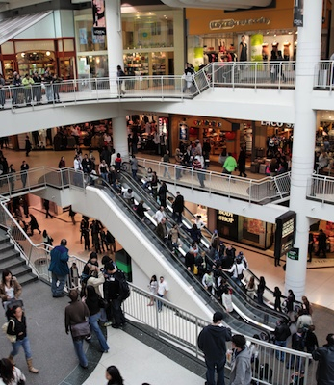

傳統實體商店
Brick and Mortar
線上購物
Click and Order
轉為
to

Slide 31
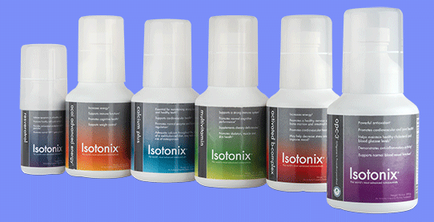



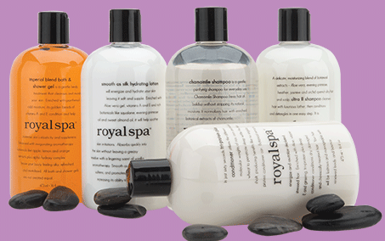



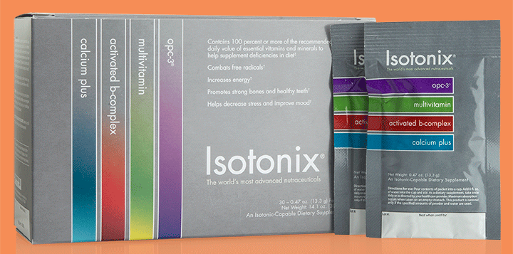

獨家代理品牌
Exclusive brands
更優質產品
Better PRODUCTS
更優惠價格
Better Prices
現金回贈
Cashback for
customers
現在就開始找出那些你可以在美安購買的
產品，並停止購買其他品牌，如此才是真正落實購物年金。
Start identifying which of the company’s exclusive brands you could use instead of other brands to fund your Shopping Annuity®

Slide 32


我們可藉助HK.SHOP.COM來購買美安獨家產品，
此外還可以購買其他各類各樣的商品
For everything we don’t have as an exclusive brand,
you can leverage HK.SHOP.COM

Slide 33

落實購物年金，從每一位超連鎖店主完成購物年金評量開始
The Shopping Annuity begins with each UFO completing the Shopping Annuity assessment (www.shoppingannuity.com)
1
  購買美安獨家代理產品帶來BV
  Create BV with our exclusive brands
4個簡單步驟便可以建立你的購物年金
Four Steps
to build a
shopping annuity™
2
  購買美安HK.SHOP.COM夥伴商店產品，帶來IBV
  Create IBV with partner stores on HK.SHOP.COM
3
  開展複製 Create duplication
4
  透過優惠顧客建立BV & IBV
  Create BV and IBV with customers

Slide 34
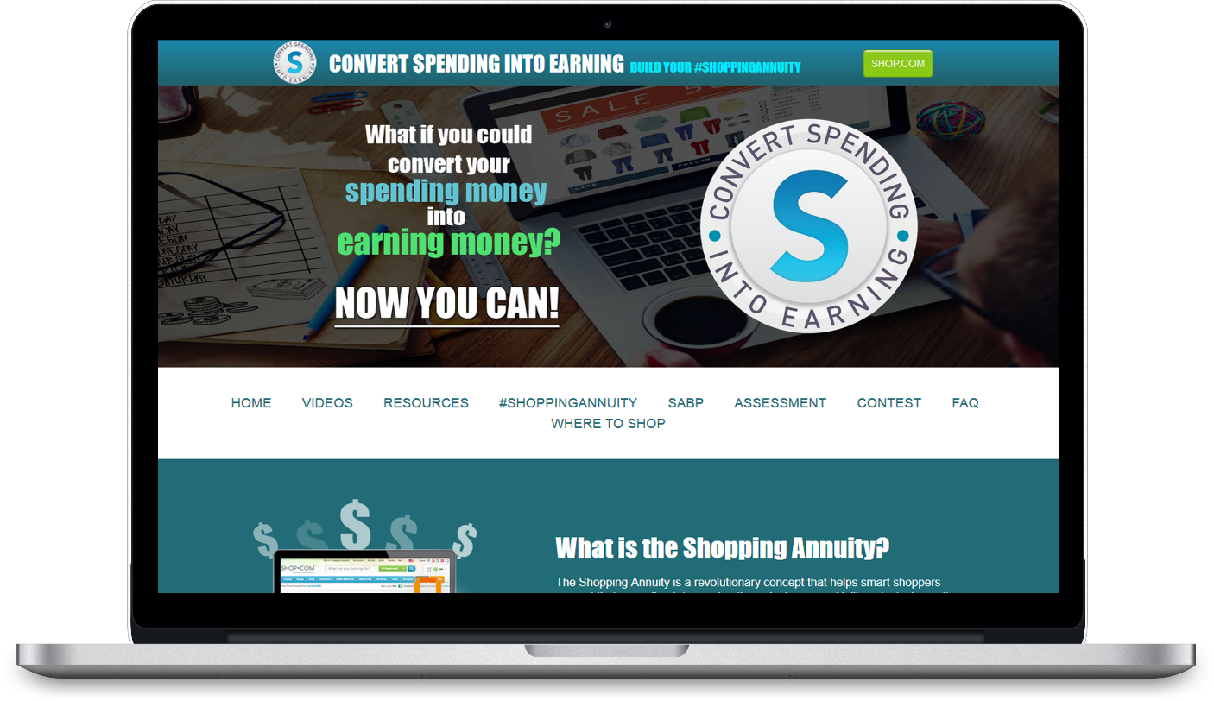
完成Complete the
購物年金評量
Shopping Annuity® assessment
購物年金評量將會協助你：
The Shopping Annuity Assessment will:
    找出你可以使用美安獨家品牌產品取代的家用品
    Identify the products you could replace with the company’s exclusive brands
    計算出預估的BV及現金回贈
    Calculate the BV and Cashback potential
在此網址下載： Download at:
www.shoppingannuity.com

Slide 35
這是你的選擇
It’s Your Choice
你可以繼續消費，
幫別人、幫別的公司賺錢
You can continue to shop and make other companies and people money
你也可以透過購物年金，
轉消費為收入，幫自己賺錢
You can convert your spending into earning with the Shopping Annuity® and help yourself make money
或者
or
你會選擇哪一種？
Which do you Prefer?

Slide 36

超連鎖™系統
The UnFranchise™ System
一套證實可行的事業系統
A Proven System for Success

Slide 37













水平式行銷結構
HORIZONtal Marketing Structure
地產、保險、連鎖店、區域業務員／經理
REAL ESTATE, INSURANCE, SALES, TRADITIONAL BUSINESS
所有成員彼此競爭ALL IN COMPETITION

Slide 38
水平式行銷結構
Vertical Marketing Structure
鼓勵團隊合作
人人皆享100%的銷售和業績成果
不論身份，皆可賺取利潤收入
ENCOURAGES TEAMWORK
一起合作ALL WORKING TOGETHER
EVERYONE RECEIVES 100% CREDIT FOR SALES AND VOLUME GENERATED
EARNING POTENTIAL IS NOT
DETERMINED BY POSITION
ALL IN COMPETITION

Slide 39

證實可行
即時賺取零售利潤及現金回贈
不斷深入搜索業績點數
累積的業績點數有365天的有效期 （每月累積的選擇）
累積的獎勵業績點數有730天的有效期 （每月累積的選擇）
點數及下線的放置
每週支付佣金
Proven business plan
Immediate retail profits and Cashback
Volume search to infinity
Business Volume (BV) accrues for 365 days
(Monthly Accrual Option)
Internet Business Volume (IBV) accrues for 730 days (Monthly Accrual Option)
Volume and people placement
Commissions calculated weekly
美安公司管理業績紅利計劃(MPCP)之優勢
Strengths of THE
Management Performance Compensation Plan (MPCP)

Slide 40
有可能比資深夥伴賺得更多
擁有多個商業發展中心(BDC)
事業發展可以掌控
組織結構使人人都能受惠
只需建立兩個下線組織，即可創造可觀的永續收入
發展事業沒有地域限制
Ability to earn more than senior partners
Own multiple Business Development Centers (BDCs)
Business is a willable asset
Organizational structure creates common vested economic interest
Build only two organizations in depth to create ongoing significant income
Grow your business globally
美安公司管理業績紅利計劃(MPCP)之優勢
Strengths of THE
Management Performance Compensation Plan (MPCP)

Slide 41


基本業務要求 Minimum Activity
  每個超連鎖店主每月產生50 BV及10 IBV
  50 BV and 10 IBV monthly per UFO
行動的力量
Power of Your Actions
每月目標及基本十顧客
Monthly Goal and Base 10
  每個超連鎖店主每月產生200 BV及20 IBV
  每個超連鎖店主的優惠顧客每月產生300 BV及200 IBV
  200 BV and 20 IBV monthly per UFO
  300 BV and 200 IBV to Preferred Customers per UFO
購物年金及基本十顧客
Shopping Annuity® and Base 10
  每個超連鎖店主每月產生500 BV及200 IBV
  每個超連鎖店主的優惠顧客每月產生300 BV及200 IBV
  500 BV and 200 IBV monthly per UFO
  300 BV and 200 IBV to Preferred Customers per UFO

Slide 42

零售目標
Retail Sales Goal
超連鎖店主的每月目標是本人購買並使用200 BV 和 20 IBV的產品
開發至少十位優惠顧客， 並且鼓勵每人每月至少購買 30 BV / 20 IBV 的產品，
從中產生300 BV 和200 IBV
Monthly Goal for new UnFranchise® Owner is to generate 200 BV and 20 IBV from personal use
300 BV and 200 IBV to a base of at least 10 Preferred Customers ordering 30 BV and 20 IBV per month.
PC -
PC -
PC -
PC -
PC -
- PC
- PC
- PC
- PC
- PC
  優惠顧客 = 30 BV及20 IBV
  PC = 30 BV and 20 IBV
  超連鎖店主每月總共產生： 500 BV及220 IBV
  Total UnFranchise Owner Production: 500 BV and 220 IBV

Slide 43
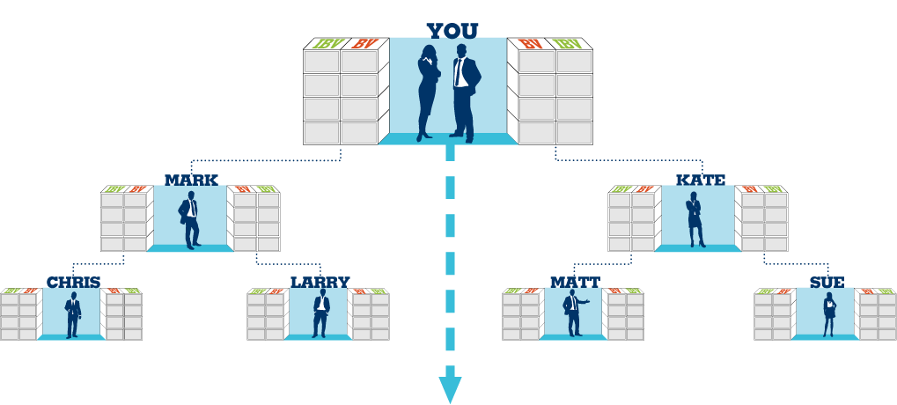

組織達到基本業務要求
Organization Satisfying the Minimum Activity Requirements
佣金 = 每個月$4,600 (BV)及每三個月$2,300 (IBV)
Commissions = HK$4,600 monthly (BV) and HK$2,300 every third month (IBV)
基本業務要求
每位超連鎖店主每月50 BV + 10 IBV 總額 = 每位超連鎖店主50 BV + 10 IBV
Minimum Activity Requirements
50 BV + 10 IBV monthly per UFO
Total = 50 BV + 10 IBV per UFO
每兩個週期你可由BV賺取$2300 - $4600及每三個月由IBV賺取$2300
You should earn HK$2,300 – HK$4,600 every other week (BV) and HK$2,300 every third month (IBV)
50 UFO’s x 50 BV =
每月2,500 BV Monthly
+
50 UFO’s x 10 IBV =
每月500 IBV Monthly
50 UFO’s x 50 BV = 每月2,500 BV Monthly
+
50 UFO’s x 10 IBV =
每月500 IBV Monthly
BV and IBV banks on this slide display weekly volume accruals

Slide 44
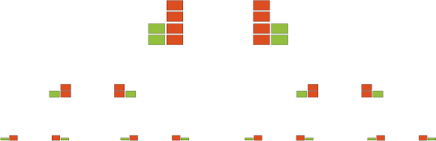
組織完成每月目標及基本10顧客
Organization Satisfying the Monthly Goal and base 10
每月目標
每位超連鎖店主每月200 BV + 20 IBV
基本10顧客
每位超連鎖店主的10位優惠顧客產生
300 BV + 200 IBV
總額 = 每位超連鎖店主500 BV + 220 IBV
Monthly Goal
200 BV + 20 IBV monthly per UFO
Base 10
300 BV + 200 IBV x 10 PCs per UFO
Total = 500 BV + 220 IBV per UFO
佣金 = 每月$46,000 (BV)及每月$23,000 (IBV)
Commissions = HK$4,600 monthly (BV) and HK$2,300 monthly (IBV)
每個週期你可由BV賺取$11,500及每兩個週期由IBV賺取$11,500
You should earn HK$11,500 weekly (BV) and HK$11,500 every other week (IBV)
50 UFO’s x 500 BV = 每月25,000 BV Monthly
50 UFO’s x 200 IBV =
每月10,000 IBV Monthly
50 UFO’s x 500 BV = 每月25,000 BV Monthly
50 UFO’s x 200 IBV =
每月10,000 IBV Monthly
+
+
BV and IBV banks on this slide display weekly volume accruals

Slide 45
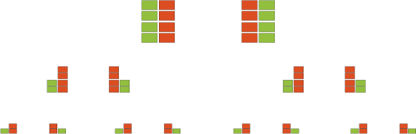
組織完成購物年金及基本10顧客
Organization Satisfying the Shopping Annuity™ and base 10
購物年金
每位超連鎖店主每月500 BV + 200 IBV
基本10顧客
每位超連鎖店主的10位優惠顧客產生
300 BV + 200 IBV
總額 = 每位超連鎖店主800 BV + 400 IBV
Shopping Annuity
500 BV + 200 IBV monthly per UFO
Base 10
300 BV + 200 IBV x 10 PCs per UFO
Total = 800 BV + 400 IBV per UFO
佣金 = 每月HK$64,400 (BV)及每月 HK$46,000 (IBV)
Commissions = HK$64,400 monthly (BV) and HK$46,000 monthly (IBV)
每個週期你可由BV賺取$16,100及每個週期由IBV賺取$11,500
You should earn HK$16,100 weekly (BV) and HK$11,500 weekly (IBV)
50 UFO’s x 800 BV = 每月40,000 BV Monthly
50 UFO’s x 400 IBV =
每月20,000 IBV Monthly
50 UFO’s x 800 BV = 每月40,000 BV Monthly
50 UFO’s x 400 IBV =
每月20,000 IBV Monthly
+
+
BV and IBV banks on this slide display weekly volume accruals

Slide 46
基本業務要求 Minimum Activity
行動的力量
Power of Your Actions
  平均每月佣金HK$5,400
  HK$5,400 average monthly commissions
每月目標及基本十顧客
Monthly Goal and Base 10
  平均每月佣金HK$69,000
  HK$69,000average monthly commissions
購物年金及基本十顧客Shopping Annuity and Base 10
  平均每月佣金HK$110,400
  HK$110,400 average monthly commissions

Slide 47


